Slide 1
College Admission Agent - RAG-based AI Assistant
CAPSTONE PROJECT
Presented By:
Utkarsh Apoorv
Pranveer Singh Institute of Technology, Kanpur - CSE

Slide 2
OUTLINE
Problem Statement
Proposed Solution
System Development Approach
Prompt Grounding & Deployment
Result (Watsonx chat)
Conclusion
Future Scope
References

Slide 3
Problem Statement
Many students face confusion while applying to college due to unclear eligibility criteria, fee structures, and deadlines. Manual query resolution delays the process and leads to inconsistencies. There is a need for an intelligent, real-time agent that can answer admission-related queries using reliable institutional documents.

Slide 4
Proposed Solution
The proposed system aims to solve the challenge of guiding students through the college admission process by leveraging Retrieval-Augmented Generation (RAG) powered by IBM Watsonx.ai. The chatbot uses natural language processing and document grounding to provide real-time, accurate responses based on institutional admission data. The solution consists of the following components:
Data Collection:
Gather official documents such as brochures, eligibility criteria, FAQs, fee structures, and deadline notices.
Upload the collected information as a text file (e.g., college_admission_info.txt) into Watsonx.ai Prompt.
Prompt Engineering :
Design a prompt that positions the bot as an admission assistant trained on the uploaded document.
Customize response tone to ensure answers are friendly, clear, and institutionally accurate.
Model Configuration:
Select the Granite foundation model (e.g., granite-3-3-8b-instruct) from IBM’s available LLMs.
Use Watsonx.ai Prompt Lab to test the model’s ability to answer various admission-related questions in real time.
Deployment:
Save the prompt as a Deployment Notebook or Template.
Create a deployment space and expose the model via public/private endpoint. The API can be invoked via curl, JavaScript, Python, or from IBM Cloud platform
Evaluation:
Test using sample questions like.
“What are the eligibility criteria for MBA?”
Refine prompts or re-upload documents to improve grounding relevance and answer accuracy.
Result: The deployed chatbot responds to student queries instantly using trusted, grounded data.

Slide 5
System Approach
Tools Used :
IBM Watsonx.ai Prompt Lab
IBM Granite LLM (granite-13b-chat-v2 or equivalent)
Watson Studio Project (Cloud Pak for Data)
Grounded generation (RAG)
Dataset :
College admission brochure (eligibility, fees, deadlines)
Uploaded as text file: college_admission_info.txt

Slide 6
Prompt Configuration & Deployment
In this section, we describe how the RAG-based LLM assistant was built and deployed to answer college admission queries using IBM Watsonx.ai:
Model Selection:
Selected IBM Granite foundation model (granite-3-3-8b-instruct) for its instruction-following capabilities and compatibility with Watsonx Prompt Lab.
The model is grounded using institution-specific documents to enable contextual, fact-based answering.
Document Input:
Used a plain text (.txt) file containing official college admission data, including eligibility criteria, course structure, fees, and deadlines. Uploaded this file to Prompt Lab to ground the model responses to this specific information.
Prompt Engineering:
Designed a system prompt that defines the chatbot’s role as a helpful college admission agent.
Ensured the prompt included instructions for natural, precise, and document-grounded answers.
Deployment :
Saved the prompt as a Deployment Notebook within IBM Watsonx.ai.
Deployed the chatbot to a dedicated Deployment Space (“CollegeAdmission_RAG_Bot”)

Slide 7
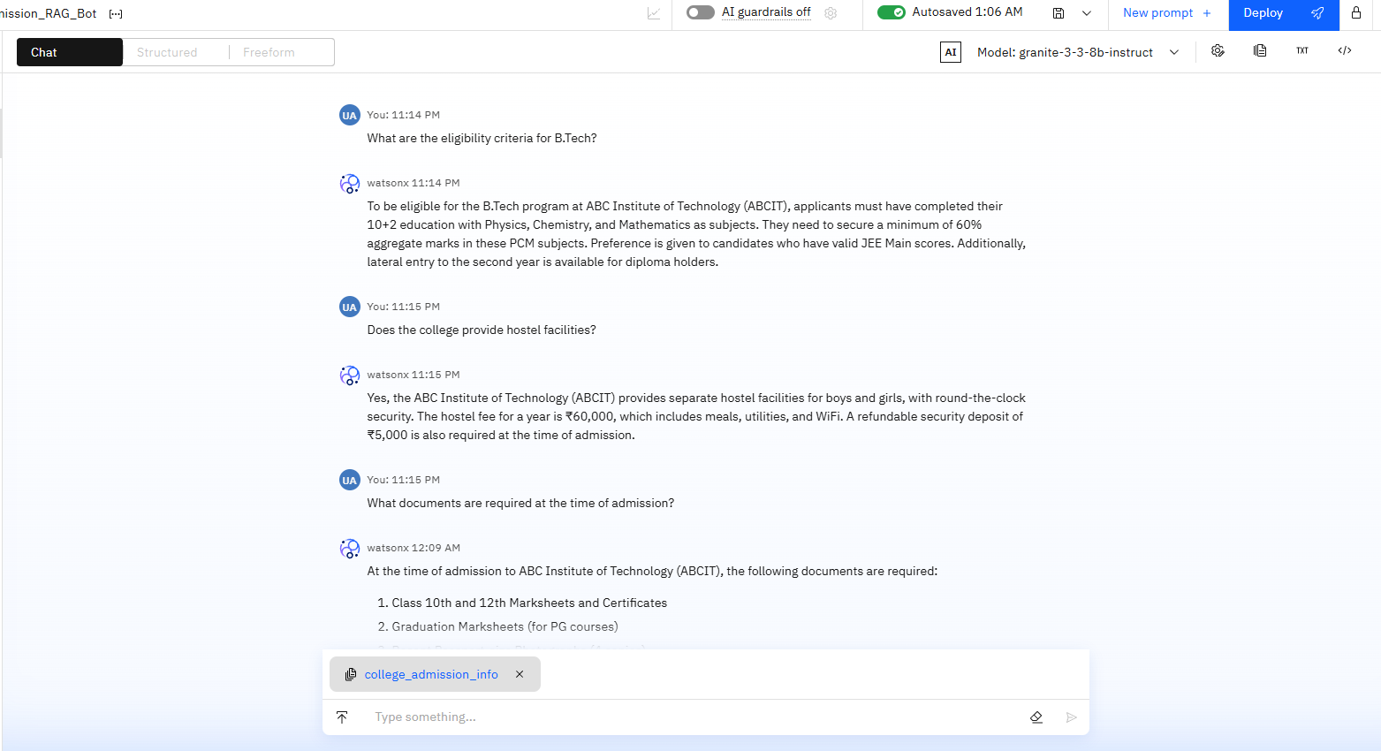
Result

Slide 8
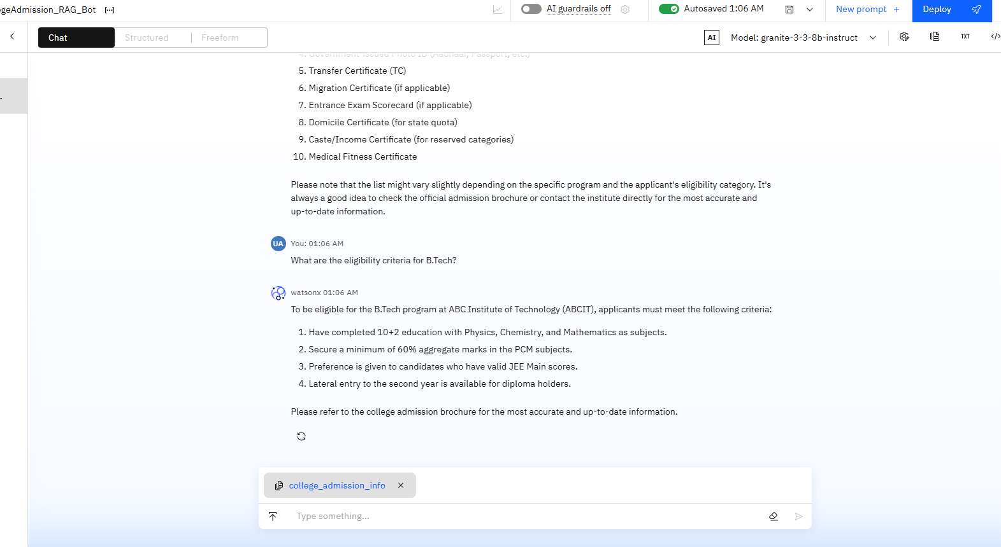

Slide 9
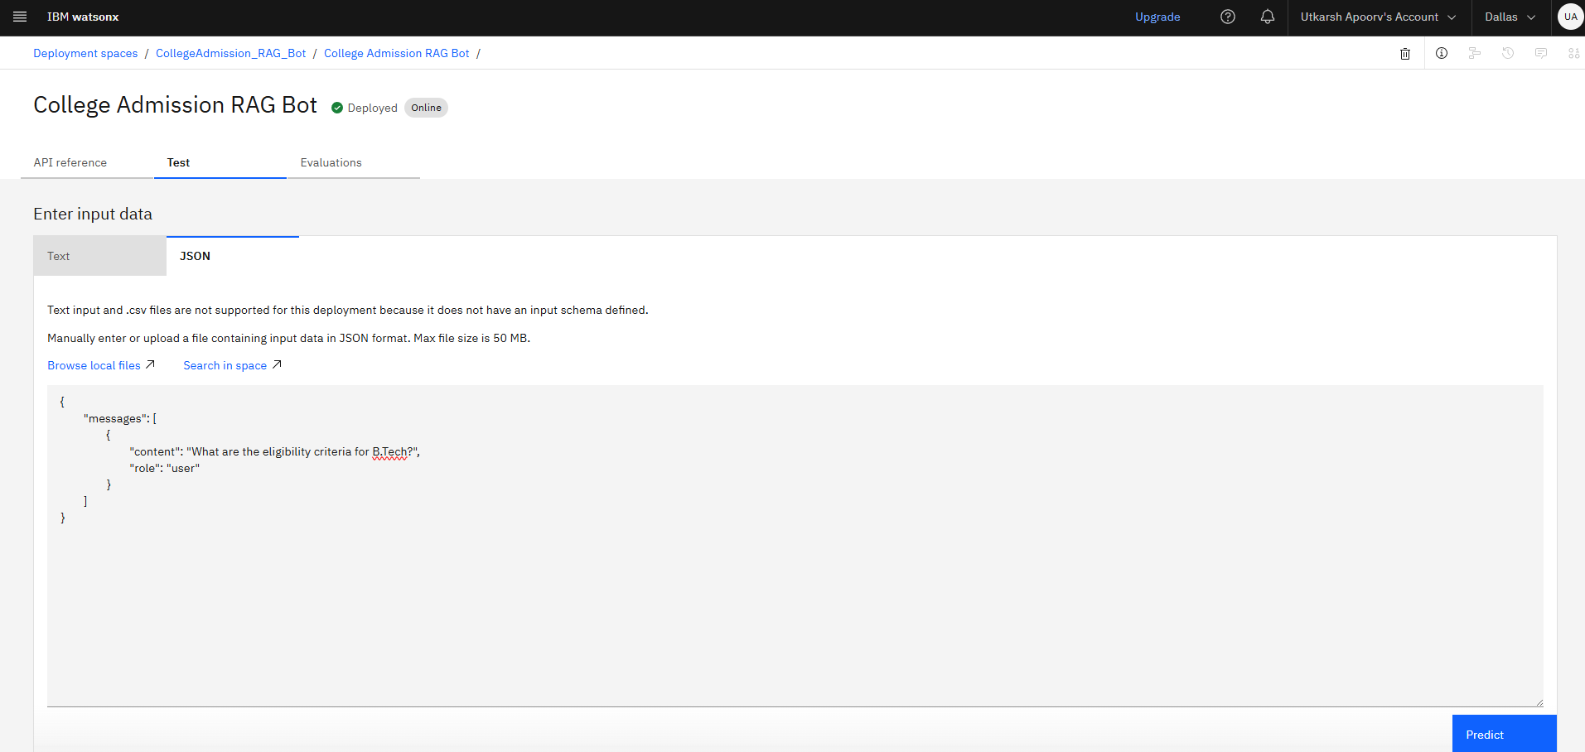

Slide 10
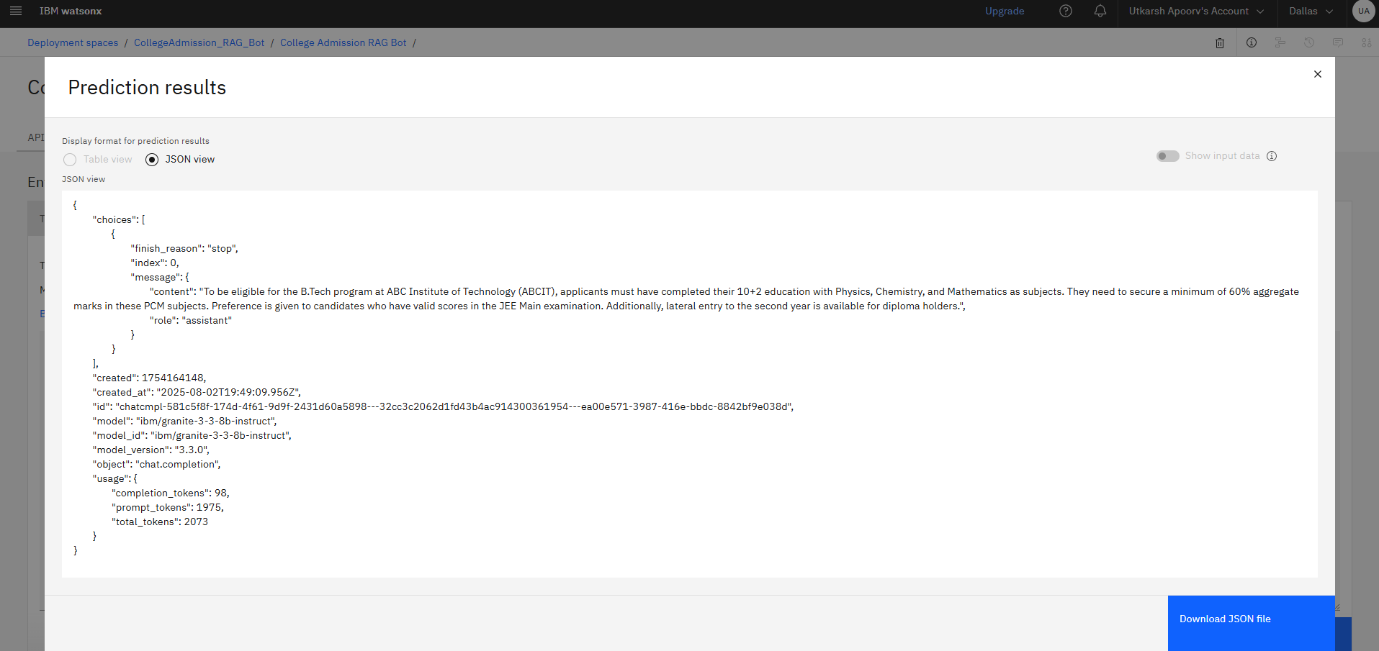

Slide 11
Conclusion
We successfully built a chatbot using IBM Watsonx.ai that provides real-time responses to student queries based on institutional data.
The no-code interface made it accessible for non-programmers.
This solution enhances student experience and reduces manual workload in admissions.

Slide 12
Future scope
Convert this into a full chatbot with Watson Assistant UI.
Add multilingual support using Watsonx LLMs.
Ground on multiple files (e.g., placement brochures, hostel policy).
Turn into API-powered website.

Slide 13
References
IBM Watsonx.ai Documentation.
IBM Prompt Lab Tutorials.
College Brochure

Slide 14
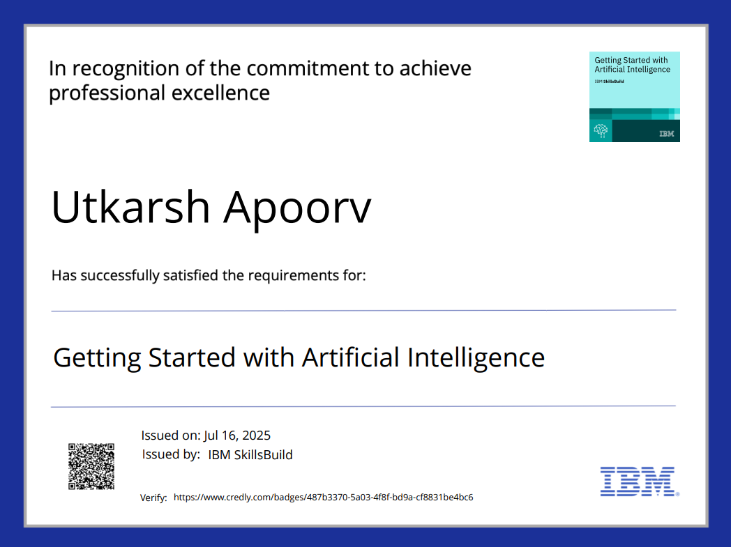
IBM Certifications

Slide 15
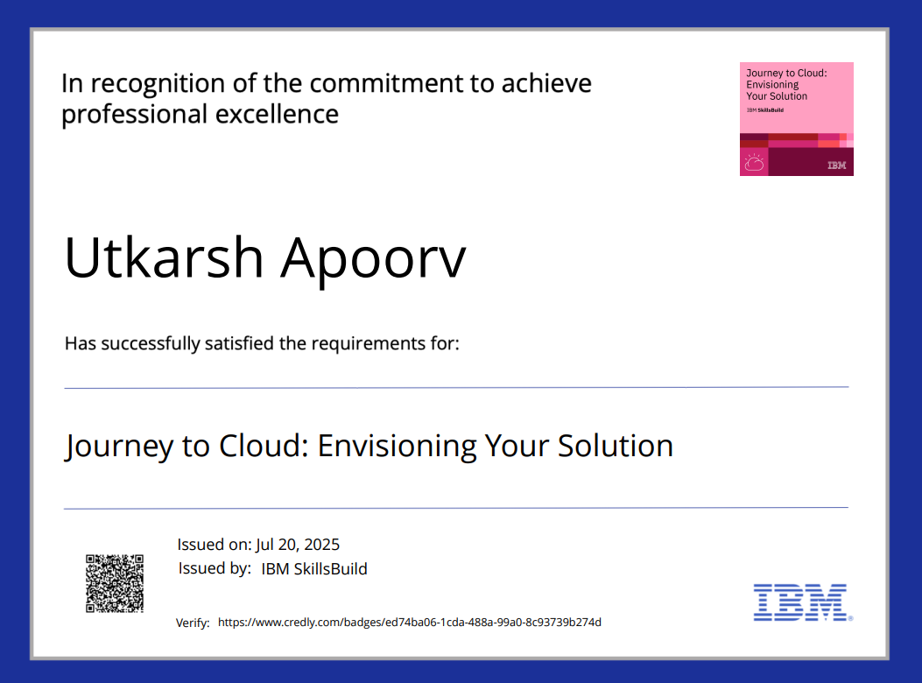
IBM Certifications

Slide 16
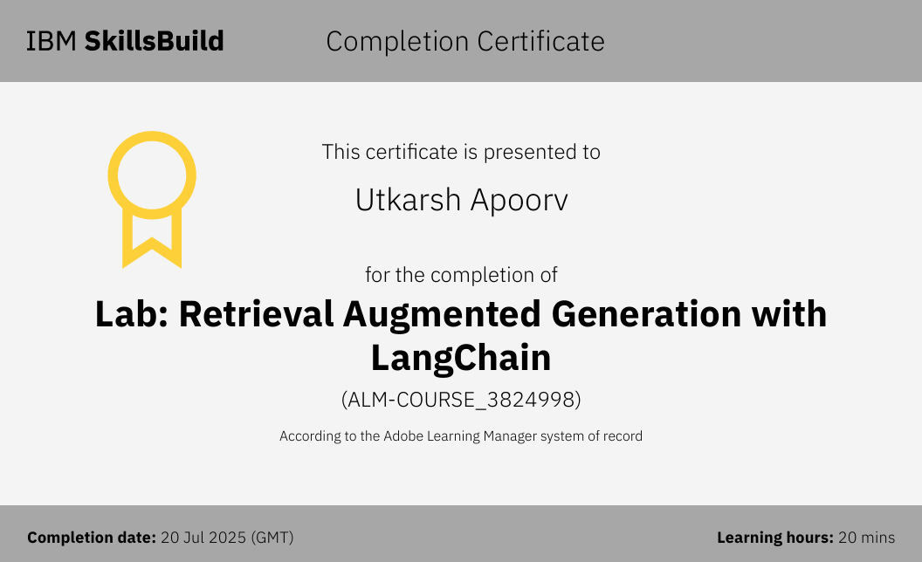
IBM Certifications

Slide 17
GitHub Link : https://github.com/MrApoorv/college-agent

Slide 18
THANK YOU

